Slide 1
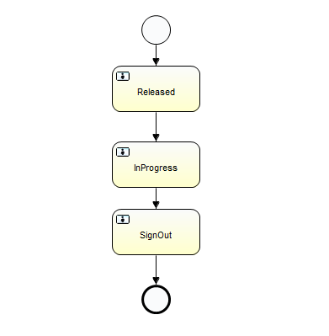
Order Flow
Items Flow
Separate Call
Call via callback

Slide 2
Using Activiti - 5.9
Oder InProgress call
Order :: Before State Changed = Released
Order :: After State Changed = InProgress
Items InProgress call
Item :: Before State Changed = Released
Item :: After State Changed = InProgress
Oder SignOut call
Order :: Before State Changed InstanceiD = InProgress
In Sign-Out Order CallBack
Call Sign-Out Item (via- CallBack)
Item :: Before State Changed = InProgress
Item :: After State Changed = SignOut -> Expecting (SignOut) with Activiti-5.18.0 like Activiti-5.9
Order :: After State Changed InstanceiD = SignOut
Using Activiti - 5.18.0
Oder InProgress call
Order :: Before State Changed = Released
Order :: After State Changed = InProgress
Items InProgress call
Item :: Before State Changed = Released
Item :: After State Changed = InProgress
Oder SignOut call
Order :: Before State Changed InstanceiD = InProgress
In Sign-Out Order CallBack
Call Sign-Out Item (via- CallBack)
Item :: Before State Changed = InProgress
Item :: After State Changed = InProgress -> Expecting (SignOut) with Activiti-5.18.0 like Activiti-5.9
Order :: After State Changed InstanceiD = SignOut
"Process state not getting changed in callback context”

